Slide 1


UMD AD CASE COMPETITION
Under the guidance of Terqueasha Wooten

Slide 2

Assumptions & Conditions
Funds were equally distributed to all the centers in historic state
Collection of larger amount of funds implies additional services on demand
Historic trends influence the cost recovered
from the centers
Centre C has not been completely exempted as they are providing services
Centre B, D are taken as cost-conscious and A being more generous
Notes:
Photo by CoWomen on Unsplash

Slide 3
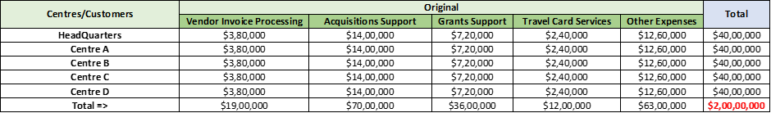
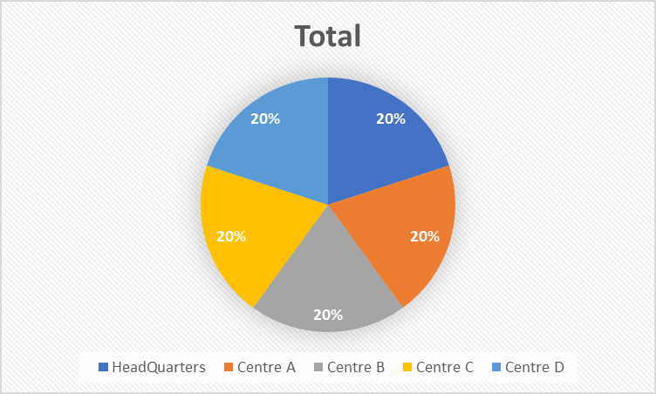
Historic State

Slide 4

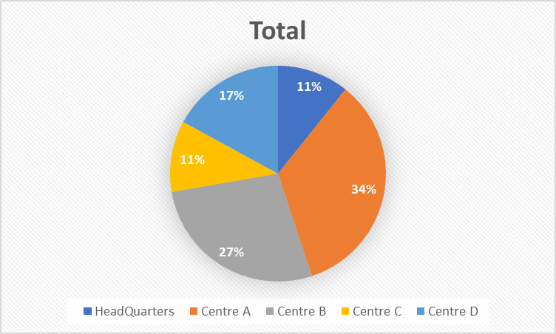
Achieved State

Slide 5
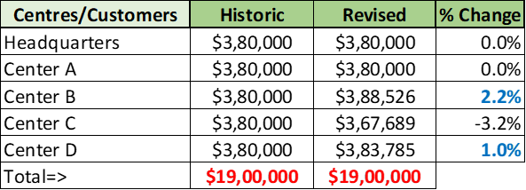
Invoice Processing Team
Adjusted cost recovery: Increased invoice processing cost for Centers B, D and reduced for C to balance allocated funds
Cost increase based on trends of past invoices processed , more allocated to B,D due to upfront investment requirement
Notes:
Since Center B and Center D had requested for extra support for vendor invoice processing we decided to recover more costs from them. To balance this out we reduced the costs recovered from C (since C had also asked for an exemption)
The amount that was increased was calculated on the basis of the past trends of the Values of Invoices Processed. More amount was dedicated to Center B since they have a concrete requirement of an upfront investment.

Slide 6
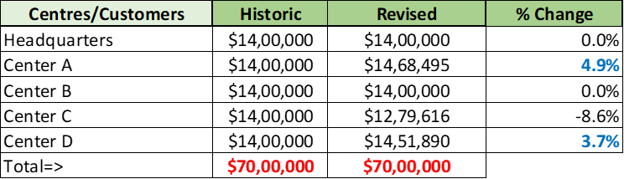
Acquisitions Support
Adjusted cost recovery: Increased acquisition supports cost for Centers A, D and reduced for C to balance allocated funds
Cost increase based on past trends of values of contracts awarded, more allocated to A,D

Slide 7
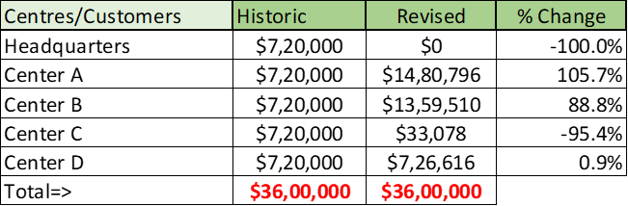
Grants Support
Adjusted cost recovery: Increased cost recovery of grants support for Centers A, B, D and reduced for C and A (full exemption) to balance allocated funds
Cost increase/decrease based on past values of grants awarded.

Slide 8
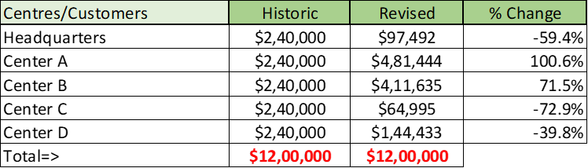
Travel Card Services Support
Revised values based on ratios of approved travel cards for FY-2023
Adjusted cost recovery: Increased Travel Services Support cost for Centers A, B, and reduced for C, D and Headquarters to balance allocated funds
Notes:
The changes for the revised values were made using the ratios of the approved travel cards for the Fiscal year 2023. Center A had the highest number of travel cards hence their revised cost was the maximum.

Slide 9
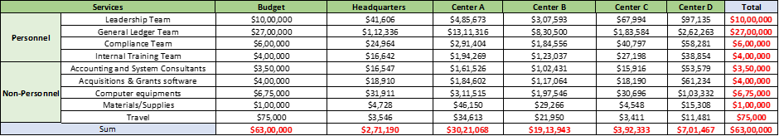
Cost recovery for other services
Cost recovery for personnel services is based on the ratio of number of employees and for non- personnel services is based on the ratio of budget
.

Slide 10
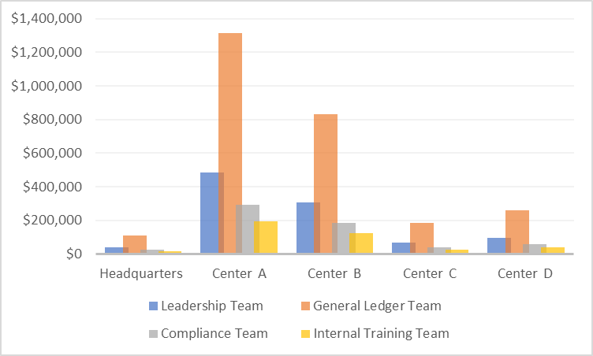
Personnel services
.

Slide 11
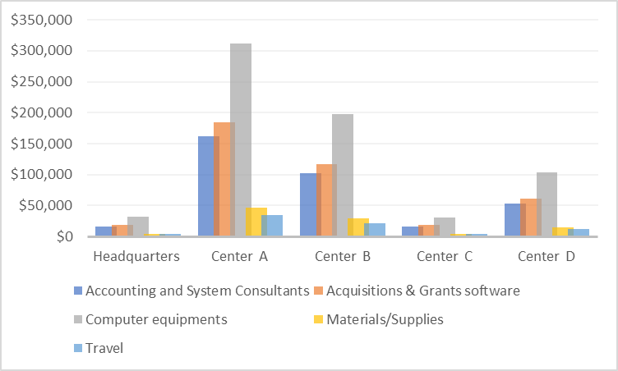
Non-personnel services
.

Slide 12
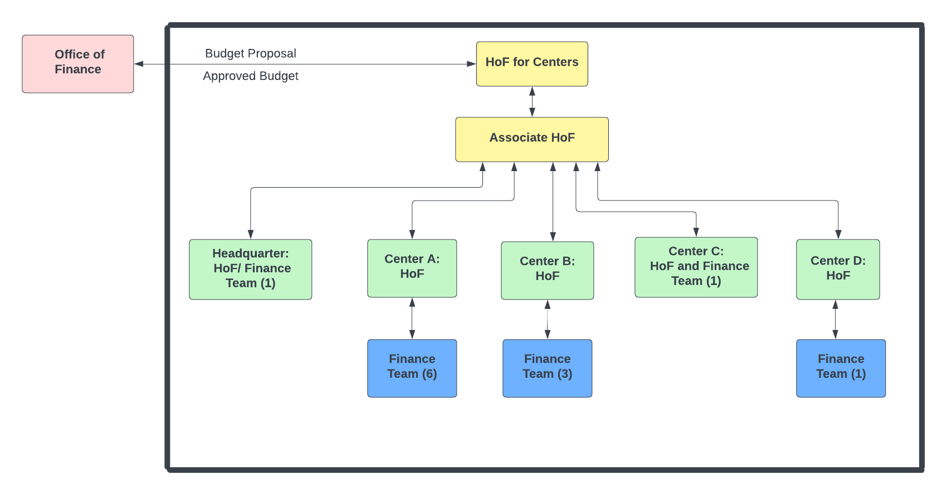

GOVERNANCE STRUCTURE

Slide 13
SUMMARY
Headquarters: Cost collections were decreased by 46.28% from the historic state
Centre A: Cost collections were increased by 70.80% from the historic state
Centre B: Cost collections were increased by 36.84% from the historic state
Centre C: Cost collections were decreased by 46.56% from the historic state
Centre D: Cost collections were decreased by 14.80% from the historic state
Notes:
Photo by bantersnaps on Unsplash

Slide 14

Thank You

